Slide 1
Communicating with Confidence & Clarity
1:1 Organizing Conversations
Alanna Martin and Mia Ragozino
KPWA, SEIU Healthcare 1199NW

Slide 2

Structured One on One Conversations
Introduction
Listen
Educate/Agitate
Ask

Slide 3
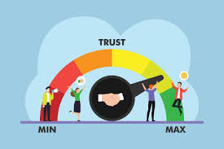
INTRODUCTION
GOAL: INTRODUCE THE TOPIC
TIP: ESTABLISH COMMON GROUND
Know who you are talking to
Establish a common understanding about the topic (ex: bargaining, PSP, Joint Staffing, issue fight, etc)
Establish and build relationship and trust
Introduce the topic- what are we here to talk about?

Slide 4


Slide 5

LISTEN
GOAL: LEARN ABOUT THEM
TIP: ACTIVE LISTENING
Find out what they care about
Connect what they care about to what we’re doing
What’s at risk for them
Use open ended questions
Reflect what you hear
Ask follow up questions

Slide 6

EDUCATE/AGITATE

Slide 7
EDUCATE/AGITATE
GOAL: PROVIDE INFO
TIP: KNOW YOUR STUFF
Give them the information they need
Connect the dots back to what they stated is important to them
Point out what’s wrong & why
Provide ideas of what it will take to win

Slide 8
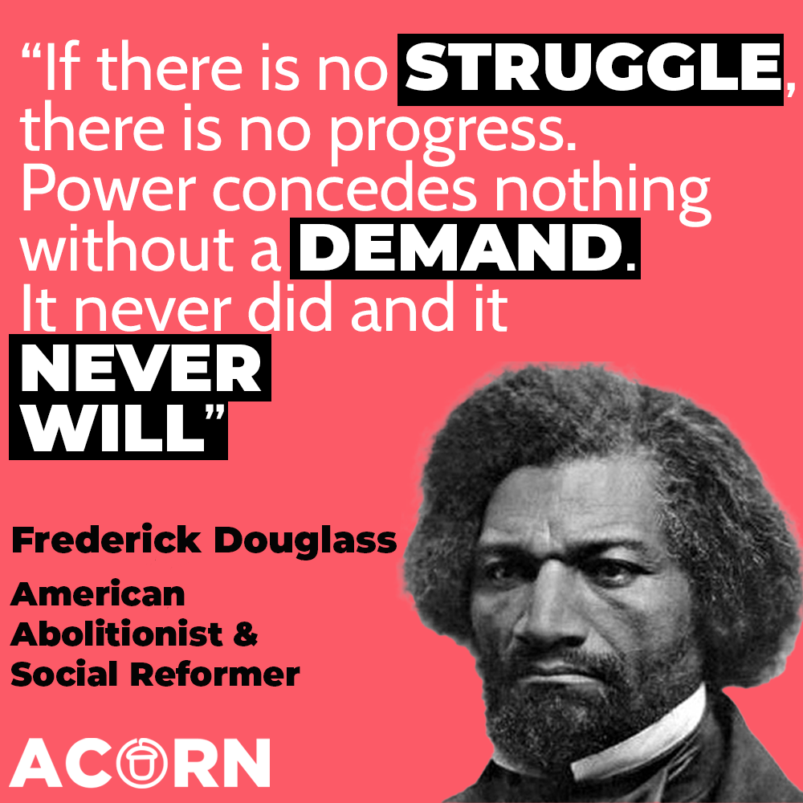

Slide 9
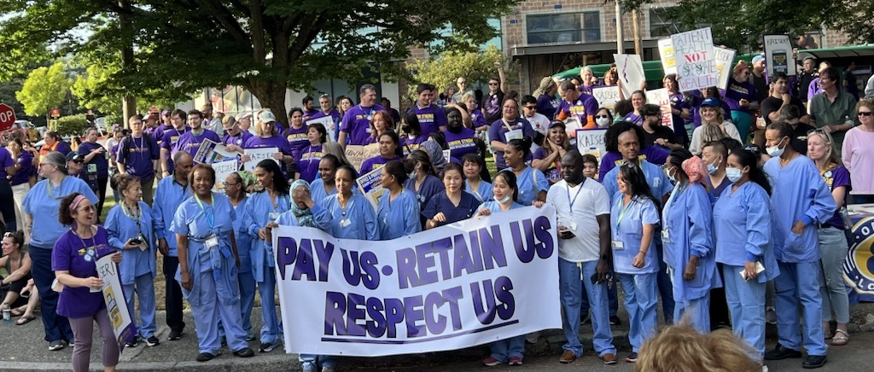
ASK
GOAL: TAKE ACTION NOW
TIP: OPPORTUNITY FOR UNITY
Give them an action to do now
Concise yes/no questions

Slide 10
Practice: Groups of 3
Introduction Listen Educate/Agitate Ask

Slide 11
Responding to Common Concerns
Affirm | Answser | Redirect

Slide 12
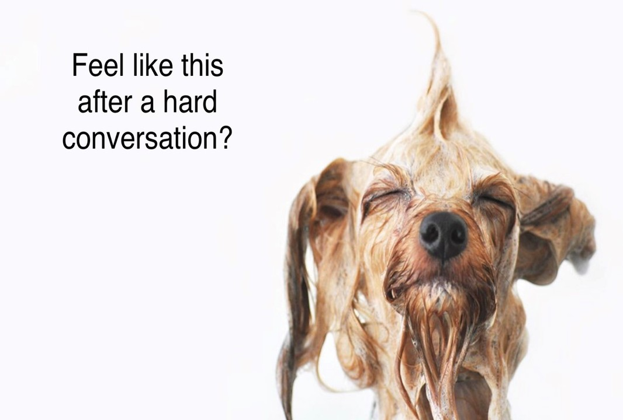
Notes:
Do you ever feel like this after a difficult conversation?

Slide 13
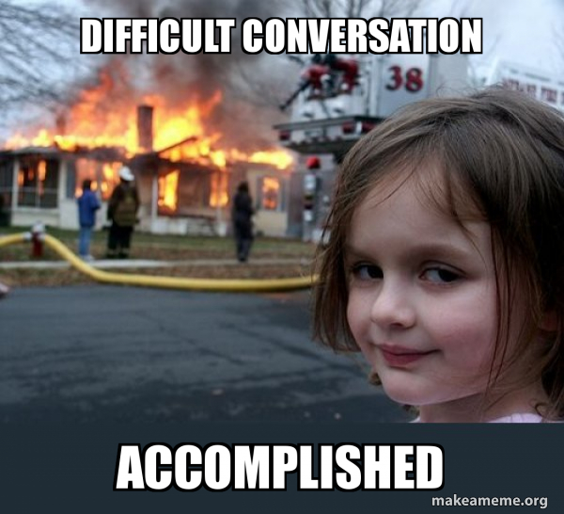
Notes:
Let’s try not to do this….

Slide 14
Challenging Conversations
What skills do we need to direct tricky conversations back to organizing/programmatic conversations
Every conversation is an organizing opportunity!
How to prepare for challenging conversations

Slide 15
What are some common concerns co-workers have shared?

Slide 16
AFFIRM ANSWER REDIRECT

Slide 17

AFFIRM
GOAL:
HELP CO-WORKERS FEEL HEARD
TIP:
LISTEN & REPEAT
Show co-workers that you are listening and understand them
Do not dispute or argue
Rephrase in your own words
Connect their concerns with yours
Be honest about concerns

Slide 18

ANSWER
TIP:
KEEP IT REAL AND TO THE POINT
GOAL:
BUILD TRUST WITH YOUR ANSWERS
Answer honestly & concisely
Stick to the facts
Do not embellish or makeup answers
Follow up if you don’t have the answer

Slide 19

REDIRECT
TIP:
CONNECT CONCERNS TO AN ISSUE IMPORTANT TO THEM
GOAL:
REMIND THEM WHAT IS IMPORTANT
Redirect to bridge their concerns to issues
Do not dispute or argue
Ask an open-ended question

Slide 20
Practice: Groups of 3

Slide 21
Choose 1 of these Scenarios for practice: 1. I don’t have time for this. I am already too stretched thin and am only one person 2. Management does what they want anyway, why should I even bother with Joint Staffing? 3. Use ideas brainstormed earlier!

Slide 22
KEY TAKEAWAYS
1 on 1 conversations are crucial to our success!
Co-workers with concerns are a normal part of organizing conversations
Address concerns by: AFFIRMing, ANSWERing, and REDIRECTing.

Slide 23
Thank you!

